Slide 1
Bitumen, buses, bikes and bodies active transport solutions for better cities
Associate Professor Matthew Burke
Deputy Director, ARC-Discovery Future Fellow and Senior Research Fellow
Urban Research Program
w. +61 7 3735 7106
m.burke@griffith.edu.au

Slide 2
Tonight’s itinerary
Why transport matters
Active travel
Public transport
Ways forward
Notes:
I am not trying to develop tonight some overarching dynamic model of transport innovation and adoption over time. That’s well beyond the scope of tonight’s presentation. But I am seeking to tease out what is innovation, who brings it about in the transport sphere, what has happened in Brisbane and Queensland over time, and what this might mean as we look over the horizon at the future.

Slide 3
Why transport matters

Slide 6
Co-benefits of investment in physical activity
Reduced financial costs
Better health
Reduced
disease burden
Increased productivity
Reduced absenteeism
Fitter kids
Better learners
Reduced congestion
Increased social capital
Improved
road safety
Active and
independent ageing
Liveable streets
Cleaner air

Slide 7
Transport matters for business
We recently surveyed 40 restaurateurs versus 300 customers
How do customers get there?
Who spends more money?
(Ghafoor, Yen & Burke, 2015)

Slide 8
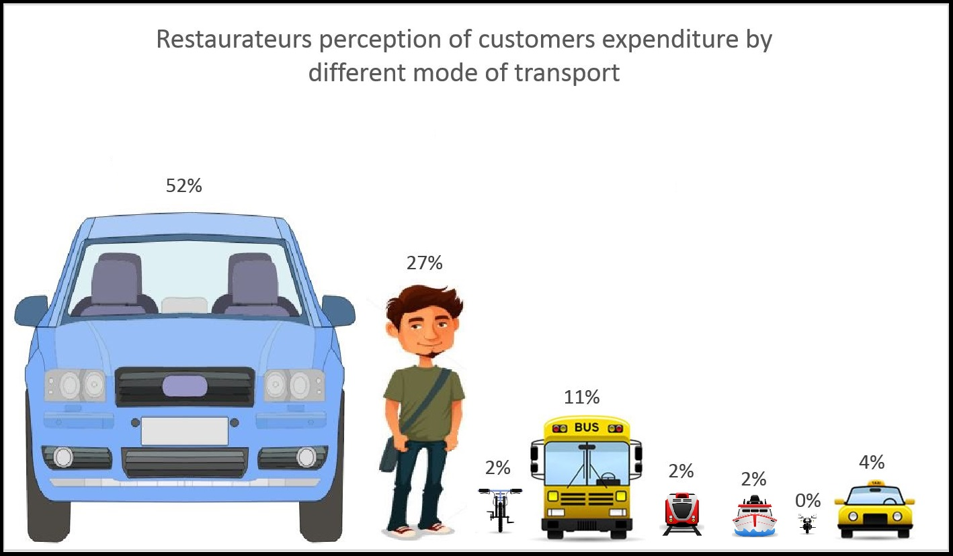

Slide 9
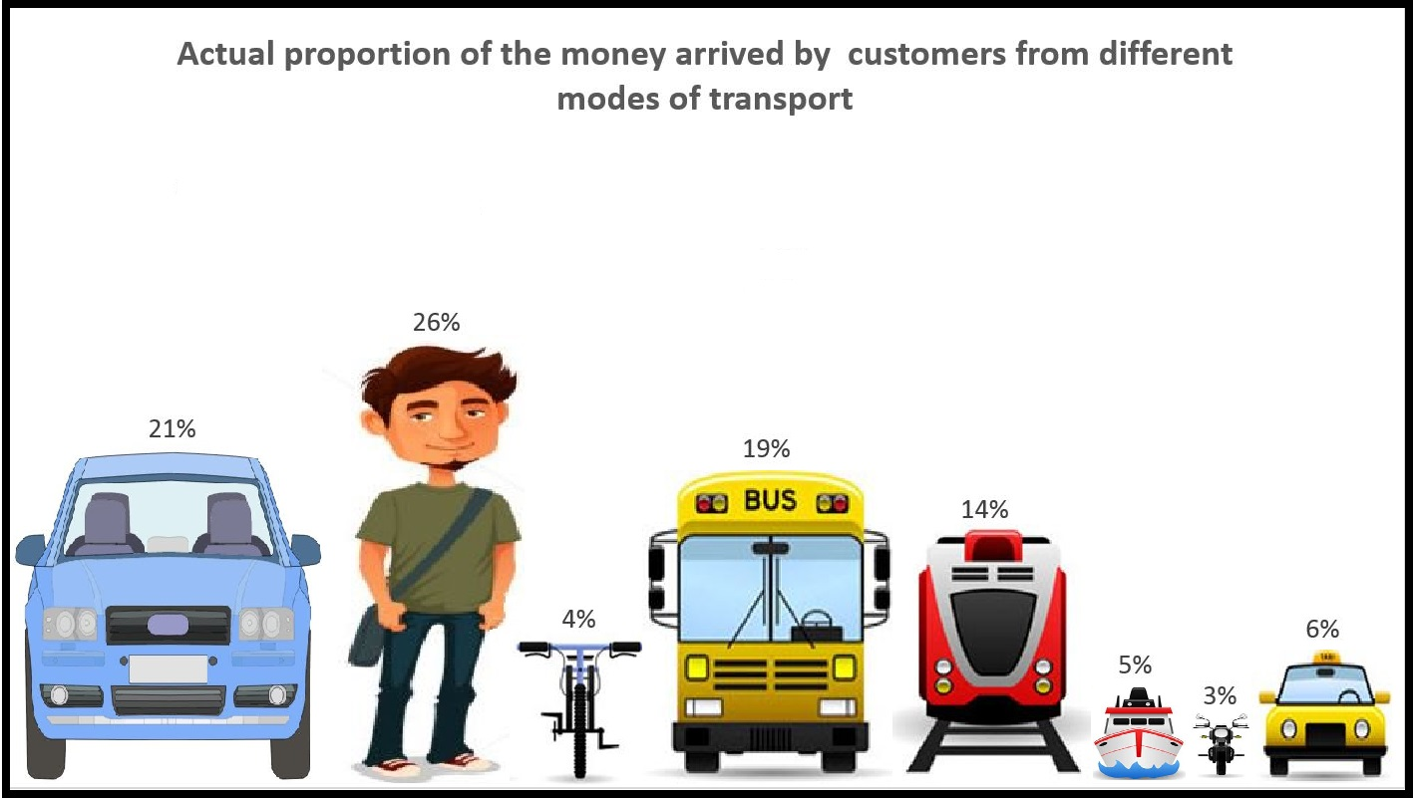

Slide 10
The death and life of active travel

Slide 11
1960s – the car was the future…

Slide 13
House and street design changed
Cul-de-sacs
Two-car garaging

Slide 15
Brisbane

Slide 16
But walking and cycling are fighting back…

Slide 17
Courtesy of Mark Dorney Queensland Department of Transport & Main Roads

Slide 20
“Investment in Active Transport Survey” Heart Foundation & Cycling Promotion Fund (2015)

Slide 21
Who is riding bikes?
The survey involved 1,006 Australians aged 25 to 59.
Cyclists were more likely to be:
Men
Higher income earners
Recreational riders (“exercise or for fun”) more so than commuters

Slide 22
“When did you last ride a bike?”
Within the last week
17%
Within the last fortnight
8%
Within the last month
9%
Within the last three months
8%
Within the last year
10%
More than a year ago
40%
Never
7%
Unsure
2%

Slide 23
“When riding, do you mainly ride on...”
Quiet roads
76%
Shared paths (pedestrians and bicycles)
61%
Road bicycle lanes
35%
Footpaths
28%
Busy roads
21%
Other
3%

Slide 24
Is there sufficient infrastructure in your local area when riding a bike…?
Yes
No
For exercise/recreation
71%
29%
To/from shops
55%
45%
To/from public transport
49%
51%
To/from work
37%
63%

Slide 25
We are yet to generate much ‘effortless’ utilitarian cycling
Current Brisbane cyclists
European cyclists

Slide 26
WALKING: Do you think there is sufficient infrastructure in your local area when walking?
Yes
No
For exercise/recreation
79%
21%
To/from shops
78%
22%
To/from public transport
75%
25%
To/from work
63%
38%

Slide 27
Do you support expanding Government funding to help fund infrastructure for bike riding, walking and public transport
Yes
71%
No
12%
Unsure
17%

Slide 28
Should Government be forced to fund walking and cycling infrastructure when building or upgrading urban road infrastructure?
Yes
62%
No
18%
Unsure
20%

Slide 29
How does your child(ren) get to and from school?
Family vehicle / car-pool
62%
Walk
31%
Public transport
19%
Bike
8%
Other
13%

Slide 30
What about children: the iMATCH and CATCH projects Burke, Curtis, Duncan, Whitzman, Tranter (2009-2014)
Focus on children’s independent mobility

Slide 31
Just a small part of our findings
Australian children crave independent travel
Parental desires to give ‘licenses’ to their children for this seem to have risen in recent years
(Significantly higher rates than found in past Australian studies)

Slide 32
But!
Neighbourhood factors prevent many children from getting this independence
Traffic danger
Fears of stranger danger
Trip distances

Slide 33
Brisbane’s Active School Travel and Queensland’s Healthy Active School Travel programs
World-leading programs
Use gamification
Adaptive on-the-ground solutions

Slide 34
SEQ Household Travel Surveys clear shifts in active travel to school

Slide 35
21st Century public transport

Slide 36
21st Century Light-Rail Currie & Burke (2013)
Melbourne:
Slowest operating speed world-wide; Ave. stop spacing 279m
Gold Coast:
99% segregated right-of-way; Ave. stop spacing 812m
Exceeding patronage forecasts

Slide 37
Bus priority works too…
Brisbane’s busways (est.2000)
Laterally and grade separated bus-only corridors
http://shoroc.com/much-learnt-for-northern-beaches-brt-from-brisbane-busway-site-visit/

Slide 38
Brisbane’s Busways
Superior operating performance to most world BRT systems
(Tanko & Burke 2013; 2014)
Source: http://cotteeparker.com.au/project/south-east-busway/

Slide 39
Better bus networks are effective
20% patronage gain for new Gold Coast network
2nd level innovations like Melbourne’s Smart Bus

Slide 40
Public transport & city building Burke & Sipe (2011, 2013) Tanko, Burke, Soltani, et al (Forthcoming)
Brisbane’s City-Cats (est.1996)
A linear (not cross-river) service
Higher-speed/ frequency

Slide 41
Brisbane ferry terminals and property values
(Tsai, Mulley, Yen & Burke 2014)

Slide 42
Key rail and busway systems are at or approaching theoretical capacity
Melbourne, Sydney and Brisbane rail
Brisbane SE Busway

Slide 43
The car is changing too
More electrified
More autonomous
More collectivised
Less km travelled (‘Peak Car’)

Slide 44
WAYS Forward

Slide 45
Blueprint for an Active Australia Action Area 4 – Active Travel
http://www.heartfoundation.org.au/SiteCollectionDocuments/Blueprint-for-an-active-Australia-Second-edition.pdf

Slide 46
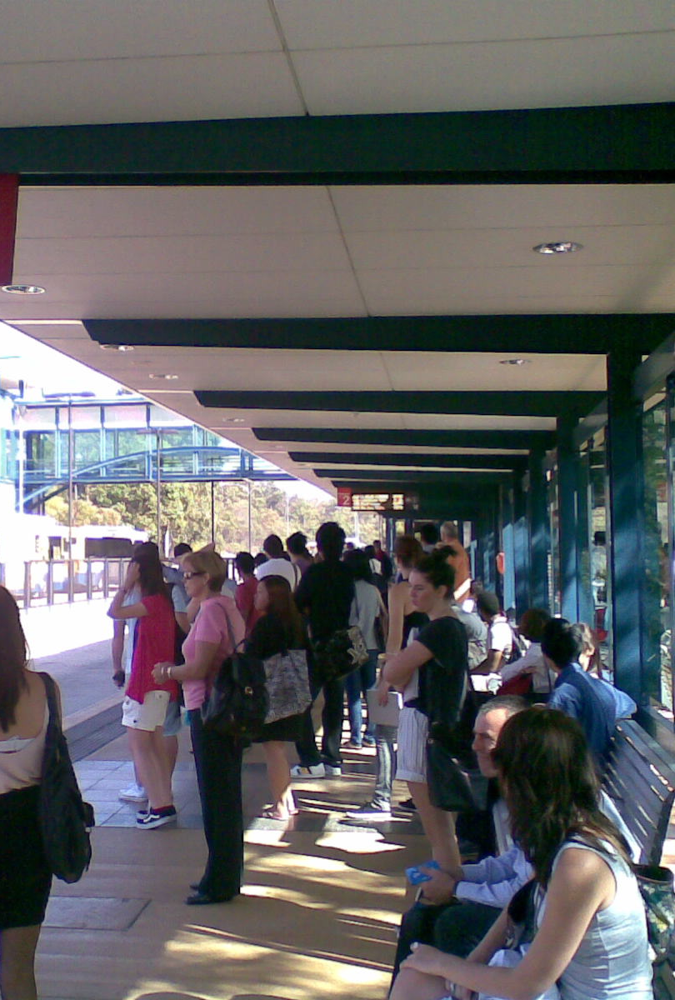
Missing ingredients
A national urban policy

Slide 47
Missing Ingredients
Replacing fuel excise as a funding source
Can we build constituencies for new instruments? (Perl & Burke 2015)

Slide 48
Missing ingredients
Distance-based pricing /user-charges
Dynamic pricing
Roads
Car parking
(See San Francisco’s efforts)
Congestion pricing
Property value capture financing

Slide 49
Missing ingredients
Commonwealth funding for public transport

Slide 50
Missing ingredients
A national physical activity action plan

Slide 51
Missing ingredients
Next steps in active transport policy

Slide 53
Any questions
Associate Professor Matthew Burke Deputy Director Urban Research Program Griffith University NATHAN QLD 4111 m.burke@griffith.edu.au Ph. 07 3735 7106

